Slide 1
WELCOME
Capitalisation in practice: Preparing programmes for implementation.
Kelly Zielniewski, Nicolas Garnier
30.06.2026 – 01/07/2026

Slide 2
What does capitalisation mean?
Transfer & reuse of knowledge generated by Interreg projects.

Slide 3
When should capitalisation happen?
At all stages of the lifecycle of the programme.

Slide 4
How can you realistically do capitalisation? One step at a time and based on the resources available.

Slide 5
WHY is
capitalisation important?
PROGRAMMES
Need to demonstrate the results & impact, as well as the EU added value.
PROJECTS
Needs to make their results visible, useful & sustainable.
CAPITALISATION
CONNECTS BOTH NEEDS
Notes:
At programme level, Interreg has an obligation to demonstrate results and impact, and to show the EU added value of what is being funded. Capitalisation shows that EU funds make a difference. It enables to feed policy processes, build thematic communities, and avoid not reinventing the wheel.
At project level, results need to produced, need to be visible, need to be understandable, sustainable and above all useful. Capitalisation brings further and stronger visibility. It opens doors to new funding, partnerships and opportunities. •Results are created by projects → only projects can make them visible, meaningful, and lasting
How do we see then capitalisation in very basic terms?
Capitalisation is the thing in-between that connects these two needs. Programmes can hardly do that without relevant and well packaged results. And projects need the programme support, tools, mechanisms, methodologies, trainings, to make their results more visible, useful and sustainable. Capitalisation can connect both needs and transform local actions into meaningful impact, and potential change at a higher scale.
Capitalisation sits between programme needs and project needs.
Programmes need meaningful, reusable results to demonstrate value and generate impact.
Projects need support, methods and opportunities to make their results visible, useful and sustainable.
Capitalisation connects both sides.

Slide 6
Agenda
01
02
03
State of play: Where does my programme stand?
Capitalisation into the programme lifecycle
Making capitalisation happen
04
05
06
Bottlenecks & ways around them
Your capitalisation action plan
HIT

Slide 7

Discussion in groups (5 min)
At your table, briefly introduce yourself and explain:
What's currently your biggest challenge when it comes to capitalisation?
What's this one small step, success or practice your programme already has in place?
Notes:
Remind people about ground rules.

Slide 8
STEP 01
Where does my programme stand?
Kelly Zielniewski/ 30.06.2026
Notes:
Understanding your programme's current situation

Slide 9
Self-assessment (15 min)
Go to workbook, Step 1 (p.3):
Read the different statements and rate each of them from 1 to 5 (1 being not all true, 5 fully true).
Then calculate your subtotal for each pillar and identify your strongest pillar, your weakest, the direction your programme could take (p.4).

Slide 10
Discussion in pairs (10 min)
Turn to the person seated next to you and briefly discuss your results:
Which pillar is strongest?
Which one is weakest?
What explains that result?
Where do you see the biggest opportunity for improvement?

Slide 11
WHAT does a programme do to support capitalisation?
STRATEGIC POSITIONING
PROGRAMME MECHANISMS
SUPPORT & FACILITATION
Notes:
Looking at the self-assessment, you may have noticed that the questions did not focus on a single aspect of capitalisation. That's because capitalisation is not only about projects, events or communication. It requires a combination of strategic choices, programme mechanisms and support activities. We have grouped these dimensions into three pillars.

Slide 12

STRATEGIC POSITIONING
WHY are we doing capitalisation?
Shared understanding
Clear objectives
Clear vision
Links to programme priorities
Internal ownership
Notes:
The first pillar is about direction: Why are we investing time and resources in capitalisation? What are we hoping to achieve? Is there a shared understanding across the programme team?
Programmes with strong strategic positioning tend to have a clearer vision and stronger internal support.
Capitalisation is much easier when people understand why they are doing it → Sense of ownership.

Slide 13

PROGRAMME MECHANISMS
HOW is capitalisation embedded?
Calls
Selection
Procedures
Monitoring
Processes
Notes:
The second pillar is about how capitalisation is built into programme practice. This includes the mechanisms programmes use to encourage projects to build on results, identify promising practices and support reuse.
Many programmes are currently exploring this area because it moves capitalisation beyond individual activities and embeds it into programme processes.
Capitalisation becomes more sustainable when it is part of the way a programme operates.

Slide 14

SUPPORT & FACILITATION
HOW do we support projects?
Guidance
Exchanges
Learning
Stakeholder engagement
Support for transfer and uptake
Notes:
The third pillar focuses on people. Even with good procedures, projects often need support to identify reusable results, connect with stakeholders and explore opportunities for transfer.
This pillar is about creating the conditions for learning, exchange and collaboration.
Capitalisation rarely happens by itself.
All 3 pillars matter:
Strong support activities alone are not enough.
Strong procedures alone are not enough.
A strong vision alone is not enough.
What we often observe is that programmes are stronger in some areas than others. Some programmes have many support activities but limited mechanisms.
Others have procedures but little ownership. Others have a vision but few practical tools.
Now, coming back to the self-assess,ment, the objective is not to score highly everywhere. The objective is to understand where your programme is today and where there may be opportunities for improvement.

Slide 15
Plenary (10 min)
Which pillar is strongest?
Which one is the weakest?
Collective reflection, Q/A
Notes:
Think of a few questions to boost the reflection here in plenary.
Let’s compare where programmes stand
Use the self-assessment to reflect together:
Which pillar seems strongest across the room?
Which pillar appears most challenging?
Do programmes tend to be stronger in support activities, in mechanisms, or in strategic positioning?
What surprised you in your own results?
What does a “weak pillar” usually mean in practice?

Slide 16
Break
Notes:
10:45 – 11:15

Slide 17
STEP 02
Capitalisation in the programme lifecycle
Nicolas Garnier, Kelly Zielniewski / 30.06.2026
Notes:
Where can we act? Exploring capitalisation across the programme lifecycle.

Slide 18
The bigger picture
1
RESULT
2
IMPACT
3
CHANGE
What is the main achievement of your project?
What have you produced?
Has something changed?
Any long-term, lasting influence?
Is there any
positive effect?
The aim is not only to produce something, but to enable positive change that lasts
Notes:
What are we aiming for with capitalisation? The uptake of project results so they contribute to the bigger picture. At the first level, we have results, the achievements projects produce. Capitalisation goes further by helping those results generate impact, meaning a positive change in practice, behaviour or policy. The longer-term ambition is lasting change, when that impact spreads, becomes embedded and continues after the project ends.

Slide 19
What is, and is not, an impact?
Impact is not (just) numbers
IMPACT
Numbers can support the story, but they do not describe the change.
Positive, meaningful CHANGE
It is about positive, meaningful change
What improved, for whom, and why does it matter?
Not an activity, an award or a number on its own
It also needs other components
Takers, end-users, scale, time … and the way change is achieved.
Notes:
Impact is not just numbers. Numbers can help tell the story of achievements, but demonstrating impact means describing the positive change, how it was achieved, who benefits, at what scale and over what period. Keep the distinction clear: activities are what projects do; impact is what changes because of them.

Slide 20

Interreg example: WARM HOMES
IMPACT STATEMENT
To reduce household energy poverty (POSITIVE CHANGE), the project equips 25 municipalities (TAKERS) with a tested one-stop-shop model (HOW), helping 2,000 vulnerable households (END-USERS / SCALE) access renovation support within three years (WHEN).
Challenge
Households struggle to access energy renovation support
POSITIVE CHANGE
HOW
TAKERS
Project result
A tested one-stop-shop model for municipalities
END-USERS
WHEN
Notes:
This is an illustrative example, not a real project. The purpose is to show that an impact statement goes beyond the number of activities or outputs. It describes the positive change, the mechanism, who takes up the result, who ultimately benefits, the scale and the timeframe.

Slide 21
Three levels of capitalisation
A programme can start with one level and progressively build towards the next
3
2
1
Activate the reuse of results
Create synergies between projects
Take stock & organise results
Enable uptake beyond the original project
Combine, compare and strengthen
Know what the programme has produced
Transfer to new stakeholders, territories and policy
Clusters, communities and thematic knowledge
Organise evidence, results and knowledge
The direction of travel: from knowing results, to strengthening them, to enabling reuse and lasting change
Notes:
Level 1 is about taking stock and organising project results. Level 2 creates synergies between projects, for example through thematic communities, clusters or dedicated capitalisation actions. Level 3 actively enables reuse by other stakeholders and can contribute to policy change. Programmes do not need to do everything at once. The important point is to know which level they are aiming for and what conditions it requires.

Slide 22

Thematic capitalisation
Clustering, communities and other ways to connect project knowledge
CONNECT
GROW
REACH
Create links between projects to improve quality of results and their impact
Support the visibility and reach of the programme and its results to stakeholders outside Interreg
Encourage new partnerships for future projects
Notes:
Many programmes use thematic communities, project clusters or similar structures. Their common purpose is to connect projects so they can improve the quality and impact of results, create new partnerships, and give programme achievements a stronger reach beyond Interreg.

Slide 23

Thematic capitalisation: programme and projects aligned
Capitalisation works when contribution is expected, supported and mutually beneficial.
PROGRAMME
↗
PROJECTS
What the programme brings
What projects gain in return
✓
Make achievements visible
at programme level
✓
Plan contributions from
the outset
WIN
WIN
✓
Map and open access to
relevant stakeholders
✓
Access expertise, training
and shared tools
✓
Build a stronger voice inside
and outside Interreg
✓
Reach what one project
cannot achieve alone
Shared logic: programme-level visibility, stakeholder access and mutual benefit make thematic capitalisation worth contributing to
Notes:
The programme and project sides need to be aligned. Programmes gain visibility, access to stakeholders and a stronger voice. Projects gain expertise, training, tools and opportunities that they could not access alone. The contribution should be foreseen from the outset and presented as a win-win, not as an additional reporting burden.

Slide 24
Many programmes think about capitalisation at the end of projects BUT
it should happen throughout the programme lifecycle.
Notes:
When we talk about capitalisation, we often immediately think about project results, dissemination or closure. But programmes can influence capitalisation much earlier. In fact, some of the strongest levers sit before projects even start.

Slide 25
Capitalisation opportunities across the programme lifecycle.
Programmes can influence capitalisation at different moments, not only at closure.
PROGRAMMING
CALLS
SELECTION
IMPLEMENTATION
CLOSURE
Notes:
Capitalisation opportunities across the programme lifecycle
Programmes can influence capitalisation at different moments — not only at closure.

Slide 26
EXAMPLES
WHAT to do & WHEN?
PROGRAMMING
  Define thematic priorities for capitalisation
CALLS
  Ask applicants how they built upon previous results
SELECTION
  Assess transferability and reuse potential
IMPLEMENTATION
  Discuss capitalisation during project reviews
CLOSURE
  Identify and promote reusable results
Notes:
These are not the only possibilities. They are simply examples of how programmes can embed capitalisation at different moments.
Some actions are very light-touch and require little effort. Others are more ambitious.
The important point is that capitalisation is not limited to the end of projects.

Slide 27
Individual reflection (15 min)
Go to workbook, Step 2 (p.5) and reflect individually on the following:
What does my programme do under each stage (first column)?
Notes:
Focus on the first column. Guiding questions are available in the workbook.

Slide 28
Group discussion (20 min)
Discuss at your table:
Which stage is already strong?
Which stage is weak? What is missing?
What can you realistically improve?
Notes:
Then Nico takes over for 10 min to debrief in plenary:
One interesting practice you have heard at your table
One improvement idea
Invite them to go to the workbook to complete based on what they have heard (improvement idea column).

Slide 29
Lunch
Notes:
12:30 – 14:00

Slide 30
STEP 03
Making capitalisation happen: Exploring practical approaches
Nicolas Garnier, Kelly Zielniewski / 30.06.2026
Notes:
What can we do? Identifying practical approaches and programme mechanisms.

Slide 31
Making capitalisation operational
Three levers programmes can use without creating a heavy new system
Implementation support
Calls & selection
Transfer & reuse
Build capitalisation into requirements and assessment
Help projects identify, test and prepare reusable results
Connect results with takers, stakeholders and policy
The programme role is to create the conditions, support progress and connect results to opportunities for uptake
Notes:
This section is a short overview of three operational levers. Programmes can build capitalisation into calls and selection, support projects during implementation, and connect results with potential users and policy processes. The emphasis is on realistic adjustments to existing programme mechanisms.

Slide 32
Capitalisation mindset from the outset
When planning an Interreg project, the starting point is solving a territorial challenge that is:
Demand-driven
Relevant
Responds to the needs of a
specific target group
Responds to priorities of
the programme and EU
Territorial
challenge
Result-oriented
Cooperation added-value
Addresses the need, agreed
from the start
Solves challenges across
borders
Two additional capitalisation lenses
Building on existing results
End-users uptake and impact
What proven knowledge, practices or tools
can the project use, adapt or advance?
Who is expected to take up the result,
and what change should happen beyond
the partnership?
Notes:
Start with the usual Interreg project logic: demand-driven, relevant, result-oriented and based on cooperation added value. Then add two capitalisation lenses. First, what existing results or practices can the project build on? Second, for whom is the result being developed, who should take it up and what impact should it create? The two right-hand cards appear after the initial criteria.

Slide 33
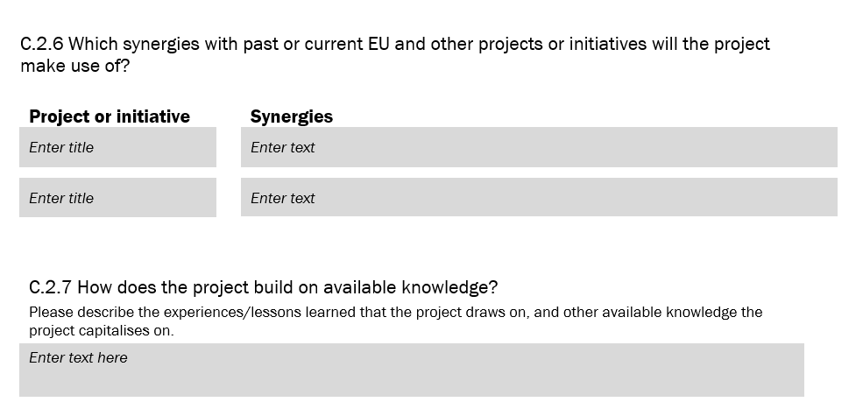

Building on results : HIT template questions
Do you have such questions in your application form? Share your example!
Notes:
HIT already includes questions that can support this mindset. Invite participants to identify whether their own application forms ask how projects build on existing practices, avoid duplication and demonstrate an evolution of ideas.

Slide 34
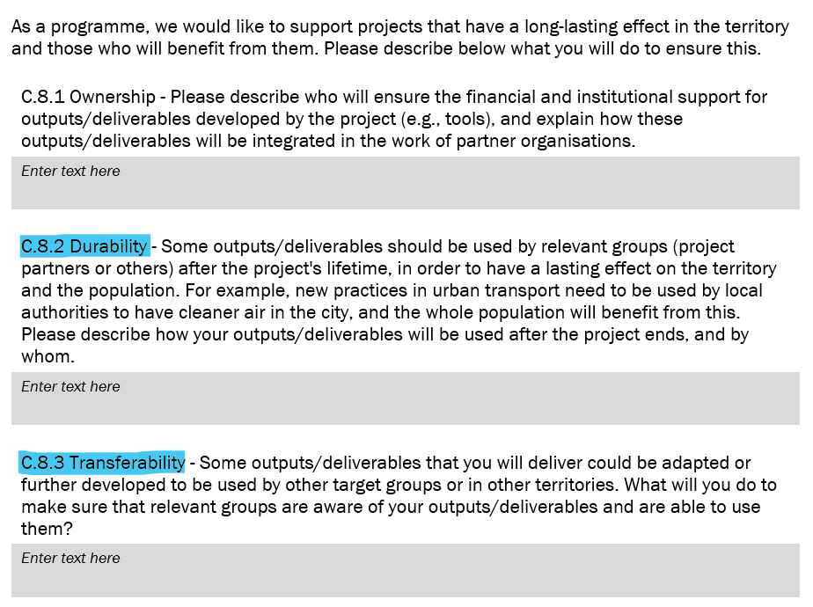
Building on results : HIT template questions
Essential that outputs are thought with transferability and
lasting impact in mind from the start…
Notes:
The same principle applies to outputs. Projects should explain how outputs are designed for transferability and lasting impact from the outset, including who is expected to use them and under what conditions.

Slide 35

What makes a result transferable?
Useful, understandable, tested, adaptable, accessible
Relevant to others and usable beyond the original project context
Substantiate what is meant by “good project”
The objective is not visibility only, but:
Uptake
Adaptation
Re-use
Long-term impact
Notes:
We have used these terms to describe capitalisation potential so far…

Slide 36
Operational criteria for transferability
Questions programmes can use in applications, assessment and project reviews
RELEVANCE
Does it address a need confirmed beyond the project partnership?
EVIDENCE
Has it been tested and validated with users in real conditions?
OWNERSHIP
Is someone responsible for maintaining, updating and sharing it?
ACCESS
Are the result, guidance and evidence easy to find and use?
ADAPTABILITY
What can change in another context without losing the core value?
FEASIBILITY
Are costs, skills, permissions and resources clear?
DEMAND
Are potential takers identified and engaged early enough?
Notes:
These criteria move beyond communication quality and focus on operational readiness. They can be used in calls, selection, project monitoring and pre-closure reviews. A result with transfer potential should respond to a wider need, have evidence, clear ownership, accessible guidance, adaptability, feasible conditions and visible demand from potential takers.

Slide 37
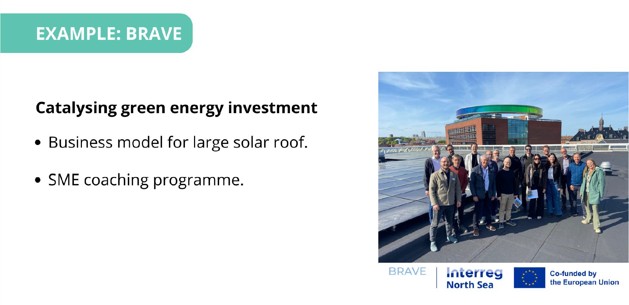
Notes:
Use the BRAVE example to illustrate a result that is concrete and potentially transferable: a business model for a solar roof and an SME coaching programme. Ask participants what additional evidence or transfer conditions they would need before promoting reuse.

Slide 38
Supporting projects during implementation
How can programmes help projects contribute to capitalisation without overloading them?
WHEN
WHAT
HOW
At which moments do we engage with projects?
Which emerging results should we look for?
What support can the programme provide?
The goal is not more reporting. It is earlier identification, better evidence and clearer preparation for uptake
Notes:
We have just covered the What, now let’s have a look at the When and the How. The programme can support capitalisation through a few well-timed interactions with projects. The key questions are when to engage, what to look for and how to provide practical support without adding a heavy parallel process.

Slide 39
Identifying reusable results early
Project results are not only found in final reports
WHERE
WHEN
Kick-off
Clarify intended users and possible reusable results
Applications and progress reports
1
Deliverables, outputs and pilots
Check what is working and what evidence exists
2
First testing
Events, study visits and peer exchanges
Mid-term
Identify emerging results and potential takers
3
Stakeholder feedback and evaluations
Follow-up activities
Pre-closure
Prepare ownership, access and transfer conditions
4
The best results are often hidden between the reporting lines
Notes:
Results can be found in formal documents, but also in pilots, events, feedback, evaluations and follow-up requests. The operational point is to look at several moments during implementation, not only at closure. Conversations with project partners often reveal valuable results that reporting systems do not capture clearly.

Slide 40
Supporting projects step by step
Three practical checkpoints during project implementation
START-UP
MID-TERM
PRE-CLOSURE
Agree intended users, existing results to build on and evidence needed
Review emerging results, user validation, takers and barriers
Confirm ownership, maintenance, guidance, access and next steps
1
2
3
Suggestions for actions
Dedicated questions in progress report
Set format for mid-term meeting
One-page result card
Present results among peers at programme level
✓
✓
✓
✓
Notes:
A realistic support rhythm can be built around three checkpoints. At start-up, clarify users, prior results and evidence. At mid-term, review what is emerging and whether it is validated. Before closure, confirm ownership, maintenance, documentation and potential takers. Light-touch tools can be integrated into existing reporting and project support.

Slide 41
From results to capitalisation
How programmes support transfer and reuse
1
2
3
4
5
RESULT
PROOF
PACKAGE
MATCH
UPTAKE
What has been produced?
Does it work and for whom?
Is it accessible and adaptable?
Who could take it up?
What support enables reuse?
Capitalisation checkpoints help programmes decide what is ready, what needs support and where to connect it
Notes:
Think of transfer as a short pipeline. A programme needs to identify the result, check evidence, ensure it is packaged for reuse, match it with potential takers and support uptake. Checkpoints can be inserted into existing project reviews so programmes know what is ready and what still needs work.

Slide 42
False 'good CAP results'
Some outputs look impressive but are difficult to capitalise
!
!
Platforms with no users
Highly context-specific solutions
!
Tools nobody maintained after project end
!
Pilots never validated by users
!
Outputs available only in national language
!
Innovation solving no real need
A successful project output is not automatically a transferable result
Notes:
Do not confuse innovation with usefulness. An output may look impressive and still be difficult to reuse if it has no users, no owner, no validation, limited accessibility or no clear need. Capitalisation is not about ticking a reporting box. It is about preparing something that others can realistically use.

Slide 43
Feeding results into policy processes
Projects
Generate concrete results and solutions
Work closely with stakeholders
Programmes
Collect, synthesise, and highlight achievements
Showcase results in libraries, events
Policies
Use evidence in reports, strategies, policy debates
Influence local, regional, national, EU priorities and future funding
Notes:
How programmes use your results in policy processes
Synthesising evidence: Programmes collect examples and data from projects to illustrate how cooperation works and what impact it has.
Feeding into reports & strategies: Your results may end up in monitoring reports, evaluations, or position papers that go to national ministries and the European Commission.
Influencing future funding: Demonstrated impact strengthens the case for future cooperation programmes and for investing in your thematic area.
Policy dialogue: Programmes use capitalisation products (e.g. thematic papers, good practice collections) in exchanges with EU institutions and networks.
Projects - Work closely with stakeholders
Programmes - Publish results in libraries, events

Slide 44
Roles in the capitalisation process
Who do you need on board
Nicolas Garnier / 30.06.2026

Slide 45
The starting point: programme ambition
Roles only become clear once the programme knows what it wants capitalisation to achieve
1
Gather knowledge and expertise on key objectives
2
Ensure the relevance of funded outputs
3
Encourage transfer to other areas or stakeholders
4
Facilitate engagement after project end
5
Ensure legacy of programme investment
6
Influence public policy and mainstreaming
23
Notes:
Relevance + avoid duplication. The ambition can be modest or high. What matters is being explicit about the result you want capitalisation to deliver –
Before discussing roles, clarify the programme ambition. Is the aim to organise knowledge, improve the relevance of outputs, transfer results, sustain engagement, ensure legacy or influence policy? The ambition determines which capacities are needed and who should do what.

Slide 46
Exercise: build the capitalisation team
Four role stations, one shared programme ambition
Monitoring Committee
National Contact Points
Programme
3
4
1
2
Projects
ADD
What actions can this body take?
RANK
Which actions matter most?
CONNECT
What does it need from the other bodies?
4 rounds of 5 minutes – EITHER flipcharts around the room, or on tables

Slide 47

Capitalisation Role card: Programme (MA / JS)
Direction and framework
✓
Define the capitalisation ambition and overall approach
✓
Translate expectations into calls, criteria and guidance
Support and coordination
DIRECTION SETTER
Provide tools, checkpoints and practical support
✓
✓
Dedicate coordination and, where possible, thematic capacity
The programme creates the framework,
keeps the overview and organises support
Results and opportunities
✓
Maintain an overview of results and promising practices
Core role in capitalisation
✓
Create networking, reuse and visibility opportunities
Notes:
MA and JS provide the framework, expectations, tools and coordination. They hold the overview of programme results, support projects and create opportunities to build on results. The role is not to do all capitalisation alone, but to organise the system and connect the other actors.

Slide 48

Capitalisation Role card: Monitoring Committee
Strategic role
✓
Align capitalisation with territorial and national priorities
✓
Trust and openness to support the capitalisation mindset shift
Opening doors
LEGITIMACY ENABLER
✓
Champion promising results within member institutions
The MC gives political weight, strategic direction and institutional reach to capitalisation
✓
Connect results to mainstream funds and policy processes
Added value
✓
Bring legitimacy that helps move beyond project-level exchange
Core role in capitalisation
✓
Reinforce awareness of Interreg among national networks

Slide 49

Capitalisation Role card: National Contact Points
Know the territory
✓
Identify needs, institutions and potential takers
✓
Spot where project results could be relevant beyond single Interreg programme
Connect and relay
TERRITORIAL CONNECTOR
Bring programme results into national and regional networks
✓
✓
Feed opportunities and stakeholder needs back to the programme
NCPs know the territory and can connect programme results to relevant networks and takers
Promote
✓
Raise awareness of Interreg results within relevant institutions
Core role in capitalisation
✓
Support dissemination through existing national/regional channels
Notes:
NCPs are territorial connectors. They know institutions, needs and networks, and can help programmes reach potential takers. They can promote results nationally, create links to policy actors and feed information about opportunities and stakeholder needs back to the programme.

Slide 50

Capitalisation Role card: Projects and beneficiaries
Generate and test
✓
Develop and validate solutions in practice
✓
Document evidence, use conditions and transfer requirements
Engage
SOLUTION PROVIDER
✓
Work with takers and end-users early enough
✓
Capture feedback that shows whether the result creates change
Projects generate evidence, engage users and make their tested solutions ready for uptake
Contribute
✓
Make outputs accessible and maintainable
Core role in capitalisation
✓
Contribute to programme communities and act as multipliers
Notes:
Projects generate and test results, but their capitalisation role goes further. They need to document evidence, explain transfer conditions, engage users and takers, make outputs accessible, and contribute to programme-level communities. Experienced partners can also act as multipliers.

Slide 51
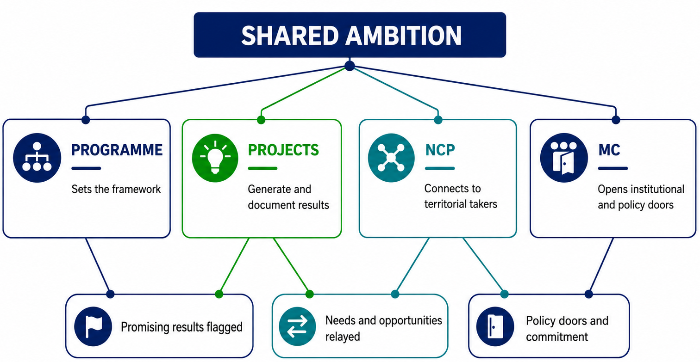
Connect the roles: all on board
Capitalisation is a shared process, a partnership at programme level
Notes:
RECAP All playing for the same team. The MA/JS translates ambition into mechanisms. Projects generate and document results. NCPs connect them to territorial actors. MC members provide trust + legitimacy and access to policy and mainstream funding. Ask participants which handover is weakest in their programme.

Slide 52
WHAT do we mean
by soft-touch approaches?
Small programme practices that help cross-border and low-capacity programmes move from capitalisation plans to action.
Low resource
Quick to set up
Build on what exists
Notes:
KELLY TAKES OVER AT 15:00.
What do we mean by soft-touch approaches?
Small programme practices that make capitalisation more systematic, without creating a heavy new process. Small actions that are are realistic for the low-capacity programmes.
CBC programmes with:
limited staff
limited time
no dedicated capitalisation officer
often no big budget for separate capitalisation activities
Gapitalisation does not have to start with a big strategy or a major new structure.
It can start with small, manageable programme practices.
They are usually:
low-resource
manageable with limited staff time and no dedicated capitalisation budget
quick to set up
they can often be tested within the current programming period
built on what already exists
they use existing calls, project reviews, reporting moments, meetings or communication channels
In other words, soft-touch approaches are a good starting point for programmes that want to do more on capitalisation, but need solutions that are realistic for small teams and limited resources.
We know that many programmes do not have the resources to build a full capitalisation system overnight. That is why it can be useful to start with light-touch approaches: small actions that fit into existing programme work, help build internal habits, and gradually make capitalisation more visible and more structured. These approaches are not a substitute for a broader strategy, but they can be a realistic entry point.

Slide 53

A few examples to get started
A set of CAP practices is on your table.
IMPLEMENTATION
CALLS/SELECTION
CLOSURE
Capitalisation questions in project reviews
One result worth reusing
Story-based result page
Challenge addressed: Projects only think about capitalisation at the end
Practice: include one short capitalisation question in review meetings or reports
Resources: ⭐ low
Challenge addressed: programmes struggle to identify what is reusable
Practice: ask each project to flag one result with reuse potential
Resources: ⭐ low
Challenge: Useful results remain hidden in long technical reports
Practice: Replace long reporting with a one-page plain-language result summary for reuse
Resources: ⭐ Low–medium
Notes:
1. Add one capitalisation question to project reporting or review meetings
Example:
What results show potential for reuse?
Who could benefit from them?
What support might be needed?
2. Ask projects to identify one result with transfer potential
Not a full portfolio.
Just one result worth exploring further.
3. Include a short capitalisation discussion in project support meetings
For example:
Are there results from previous Interreg projects this project could build on?
Are there opportunities to connect with another project or stakeholder?
4. Organise a simple exchange between 2–3 projects working on similar topics
Not a major event.
Just a short online or in-person exchange focused on lessons, tools or results.
5. Create a very simple internal list of reusable results
Not a polished database.
Just a shared Excel/Teams list of promising results, with a few lines on what they are and who might use them.
Why these are “light-touch”?
Because they:
- build on existing programme moments
- do not require a separate call or major new budget
- can be tested quickly
- help programmes start somewhere.

Slide 54
Break
Notes:
15:30 – 16:00 Do the plenary after the coffee break if needed.

Slide 55

WHAT do we want
with the soft-touch approaches?
Create possible programme responses to questions such as:
How do we help projects think beyond their own project?
How do we identify results worth keeping alive?
How do we create small but useful capitalisation habits & actions?
Notes:
KELLY TAKES OVER AT 15:00.
What do we mean by soft-touch approaches?
Small programme practices that make capitalisation more systematic, without creating a heavy new process. Small actions that are are realistic for the low-capacity programmes.
CBC programmes with:
limited staff
limited time
no dedicated capitalisation officer
often no big budget for separate capitalisation activities
Gapitalisation does not have to start with a big strategy or a major new structure.
It can start with small, manageable programme practices.
They are usually:
low-resource
manageable with limited staff time and no dedicated capitalisation budget
quick to set up
they can often be tested within the current programming period
built on what already exists
they use existing calls, project reviews, reporting moments, meetings or communication channels
In other words, soft-touch approaches are a good starting point for programmes that want to do more on capitalisation, but need solutions that are realistic for small teams and limited resources.
We know that many programmes do not have the resources to build a full capitalisation system overnight. That is why it can be useful to start with light-touch approaches: small actions that fit into existing programme work, help build internal habits, and gradually make capitalisation more visible and more structured. These approaches are not a substitute for a broader strategy, but they can be a realistic entry point.

Slide 56
Group work (20 min)
Look at the practice cards on your table, and discuss:
Which practices could really work for your programmes?
Which practices are interesting but would need to be adapted?
Which ones feel too ambitious or not relevant right now?
Any new CAP practice you can think of?
Notes:
Feedback in plenary (10min): One practice that you think could work by table.

Slide 57
Plenary (10 min)
Each table shares:
Which practices would work best?
At which stage of the programme lifecycle.
Notes:
Feedback in plenary (10min): One practice that you think could work by table.

Slide 58
Individual reflection (10 min)
Go to workbook, Step 3 (p.7) and reflect individually on the following:
What is your chosen practice? Why?
Who/What do you need to implement it?

Slide 59
STEP 04
Why is capitalisation not happening?
Kelly Zielniewski / 01.07.2026
Notes:
Capitalisation often does not fail because programmes do not care about it. It fails because programmes face real constraints: time, resources, internal buy-in, procedures, competing priorities, or lack of ownership.
What could stop us?
Understanding bottlenecks and enabling factors.

Slide 60
Types of bottlenecks
EXTERNAL
INTERNAL
Bottlenecks inside the programme (how it is staffed, organised, and equipped to support capitalisation)
Bottlenecks around the programme (in the wider landscape it operates)
Notes:
Capitalisation often does not happen for reasons that have little to do with the concept itself.
inside the programme = organisation, procedures, resources
around the programme = projects, stakeholders, uptake conditions

Slide 61

INTERNAL
Programme design
NOT A PRIORITY
Capitalisation is seen as a “nice to have” rather than as part of programme delivery and results.
UNCLEAR OWNERSHIP
If capitalisation is everyone’s job, it can easily become no one’s job.
WEEK INTERNAL SUPPORT
The programme may have some ideas, but not enough shared commitment across MA / JS / communication / coordination to move them forward.
Notes:
1. Strategic / organisational
no clear ownership
capitalisation not seen as a priority
weak internal buy-in
This is the “strategic positioning” layer: not yet about tools, but about whether the programme has made room for capitalisation conceptually and organisationally.

Slide 62
INTERNAL
Programme procedures
NOT EMBEDDED
Capitalisation is expected, but not reflected in forms, criteria, reporting or review moments.
WRONG TIMING
Capitalisation often comes too late in the project or competes with other programme priorities and deadlines.
NO FORMAL SPACE
Projects may produce useful results, but there is no structured moment to identify them and discuss what could happen next.
Notes:
Programme procedures
capitalisation not embedded in calls / selection / monitoring
no formal space to discuss reusable results
difficult timing in relation to calls or programme workload

Slide 63

INTERNAL
Capacity & resources
LIMITED STAFF, TURNOVER
Capitalisation competes with day-to-day programme management for the same people and hours.
NO DEDICATED EXPERTISE
Programme teams may want to do more, but lack confidence, methods or examples on how to organise capitalisation in practice.
NO OR VERY LIMITED BUDGET
Without even a small budget for support, facilitation or follow-up, capitalisation is often the first thing postponed.

Slide 64


EXTERNAL
Stakeholders & uptake
LATE ENGAGEMENT
Relevant institutions or users of project results are not involved early enough to shape reuse or transfer.
SOLUTIONS NOT MOVING FORWARD
Projects may produce interesting outputs, but there is no clear pathway for uptake, ownership or continuation afterwards.
LIMITED POLITICAL/INSTITUTIONAL BUY IN
Results exist, but are not packaged, described or positioned in a way that makes reuse easy.

Slide 65
Group work (25 min)
At your table, discuss:
Which bottlenecks appear most often?
Which are within our control?
What are possible ways around them?
Notes:
At tables, ask participants to compare their bottlenecks.
Discussion questions
Which bottlenecks appear most often?
Which are within our control?
Which are outside our control?
What are possible ways around them?
This is where the peer learning happens.
what exactly creates the time problem?
is it because the team is overloaded?
because the action comes at the wrong moment in the programme cycle?
because no one is clearly responsible?
because it feels like an additional task rather than part of existing work?

Slide 66
Plenary (15 min)
Each table shares their reflections/solutions (i.e. enablers/actions) identified for the bottlenecks within their control.
Notes:
Feedback in plenary (10min): One practice that you think could work by table.

Slide 67
Individual reflection (10 min)
Go to workbook, Step 4 (p.8) and reflect individually on the following:
My bottlenecks
The ones under my control
My programme response
Notes:
Participants open Workbook Page 4.
They return to the action they selected on Day 1 and complete:
My chosen action
What could prevent it from happening?
People
Processes
Resources
Timing
What could help?
Important facilitation instruction
Tell them:
Be specific. Don’t write “lack of time” if the real issue is “our call calendar is already fixed for the next 12 months”.

Slide 68
Break
Notes:
10:30 – 11:00

Slide 69
STEP 05
Design your action plan now: From ideas to implementation
Kelly Zielniewski / 01.07.2026
Notes:
Participants have now:
diagnosed their programme
looked at capitalisation across the lifecycle
explored practical approaches
reflected on bottlenecks
Now the task is simple: What is one realistic action I want to take forward after Porto?
What will we do next?
Developing a realistic action plan.

Slide 70
HOW the exercise works
WORKBOOK
Go to workbook, Step 5 (page 9). Use the questions in the workbook to turn one idea into a realistic next step (25min)
PEER REVIEW
Discuss your draft with another participant and test whether the action is clear, realistic and concrete enough (10min)
WORKBOOK
Short exchange on the types of actions emerging and what support programmes need most. (10min)

Slide 71
Go to the workbook (25 min)
Individual drafting of an action plan based on a series of questions provided in the workbook.
Notes:
Participants complete Workbook Page 5 – My Capitalisation Action Plan.
I would present it as 5 questions:
1. What is my priority area?
Strategic positioning / programme mechanisms / support & facilitation
2. What is my priority action?
The one thing I want to introduce, improve or test
3. What can I realistically do in the next 3 months?
The first concrete step
4. What would success look like in 12 months?
A realistic medium-term ambition
5. Who do I need to involve / what support do I need?
Internal and external actors, plus support needs

Slide 72
Peer review (15 min)
Discuss your draft action plan with another participant:
Is the action clear?
Is it realistic for the programme context?
Is the first step concrete enough?
Does the timing make sense?
How could the plan be strengthened?
Notes:
Ask participants to discuss their draft with one person.
Peer review questions
Is the action clear?
Is it realistic?
Is the first step concrete enough?
Does it match the programme context?
What could strengthen the plan?
This is a really important step because it helps participants refine vague ideas
.

Slide 73
Plenary (10 min)
As a group, exchange on:
What types of actions are emerging?
What support would help most?
Notes:
At tables, ask:
What types of actions are emerging?
What support would help most?
What should Interact keep working on?

Slide 74

Final
considerations
Capitalisation does not require a perfect system from day one.
Capitalisation can be embedded throughout programme practice & lifecycle.
Capitalisation is both strategic and operational.
Notes:
1. Capitalisation does not require a perfect system from day one
Small, realistic steps matter and already make a difference.
2. Capitalisation can be embedded throughout programme practice
Not only at the end of projects.
3. Capitalisation is both a strategic and operational exercise
It needs ownership, mechanisms and support.

Slide 75
STEP 06
Capitalisation by design
HIT application form and assessment criteria templates
Nicolas Garnier / 01.07.2026

Slide 76
Capitalisation mindset from the outset
When planning an Interreg project, the starting point is solving a territorial challenge that is:
Demand-driven
Relevant
Responds to the needs of a
specific target group
Responds to priorities of
the programme and EU
Territorial
challenge
Result-oriented
Cooperation added-value
Addresses the need, agreed
from the start
Solves challenges across
borders
Two additional capitalisation lenses
Building on existing results
End-users uptake and impact
What proven knowledge, practices or tools
can the project use, adapt or advance?
Who is expected to take up the result,
and what change should happen beyond
the partnership?
Notes:
Start with the usual Interreg project logic: demand-driven, relevant, result-oriented and based on cooperation added value. Then add two capitalisation lenses. First, what existing results or practices can the project build on? Second, for whom is the result being developed, who should take it up and what impact should it create? The two right-hand cards appear after the initial criteria.

Slide 77
Building on results : HIT template questions
Notes:
HIT already includes questions that can support this mindset. Invite participants to identify whether their own application forms ask how projects build on existing practices, avoid duplication and demonstrate an evolution of ideas.

Slide 78
Building on results : HIT template questions
Essential that outputs are thought with transferability and
lasting impact in mind from the start…
Notes:
The same principle applies to outputs. Projects should explain how outputs are designed for transferability and lasting impact from the outset, including who is expected to use them and under what conditions.

Slide 79
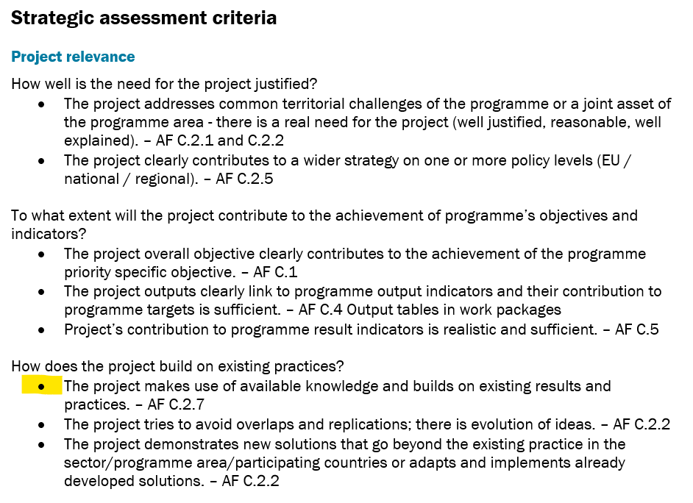
Building on results : HIT template questions

Slide 80
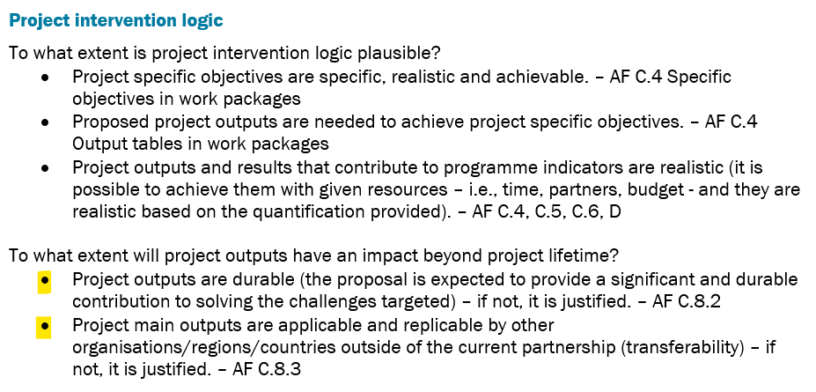
Building on results : HIT template questions
Notes:
Currently only in strategic, not operational
Not 8.1 ownership
Not in Partnership relevance

Slide 81
Capitalisation by design
What applicants should show
Starting point: building on what exists
Pathway: thought about adaptation and transfer of results
Right people: involvement of takers and end-users
Realistic workplan: activities, timing and resources support uptake
Durability and ownership: plan after closure
Notes:
Credible starting point: clear use of existing results, evidence and needs.
Coherent pathway: transfer/adaptation needs are understood from the start.
Right people: takers, users and multipliers are involved where they matter.
Realistic workplan: activities, resources and timing support uptake.
Durability: ownership and use after closure are plausible

Slide 82

Join at
slido.com
#hitcap
Capitalisation sections
Your opinion – live poll
What do you expect vs what do you actually get?
What is currently difficult for applicants to understand or address well?
What should be clearer in the AF or assessment criteria… without making the application heavier?

Slide 83
All materials will be available on:
Interact.eu/Library
Want to discuss it? Join our MS Teams environment!
Portal.Interact.eu | Programme and Project Management

Slide 84
Interact Programme
19 May 2025
Programme own consultation
Name(s)

